Slide 1
Developers Guide
Automation Anywhere Enterprise Client

Slide 2
1. Overview
1.1 Version Control
Date | Version | Developer/ CoE | Description of Change
03/21/2018 | Initial Draft V 1.1 | Siddhant Sahu | Added major sections: Development Templates, Development Guidelines
03/22/2018 | V 1.2 | Siddhant Sahu | Added another section: Metabots Library; Changed name of string file to config file and variable naming convention from sf_ to cf_; Use of InitializeRobot metabot instead of variable operations for Main Tasks; Change in Folder structure from My Tasks/Docs->RobotFolder to My Tasks/Docs->Process Area->Robotname
04/05/2018 | V 1.3 | Siddhant Sahu | Added environment specific variables within the config file and made changes in template to auto-detect environment and import respective variables Introduced the “ReadEnvironmentStrings” logic to read environment specific URLs from the config file.
04/23/2018 | V 1.4 | Siddhant Sahu | Added a date component to logfile (all modules) Added Cleanup Task Run command in the maintask (RobotName.atmx) Assigned $AATaskName$ system variable to $vTaskName$ instead of defining it manually. Added sub-sections for best practices on Terminal Emulator, Object Cloning, Delays and Email Automation. Added Logics for Metabots
05/01/2018 | V 1.5 | Siddhant Sahu | Added TestConfigFileVariableOperation Logics for the AA.PNCUtils metabots and tweaked previous logics
05/15/2018 | V 2.0 | Siddhant Sahu, Senthil Kumar | Changes to folder structure and file naming convention Added a section for general guidelines and control room best practices Minor Changes to the Main Task Template (Added a section for automatically creating Output and Log folders.

Slide 3
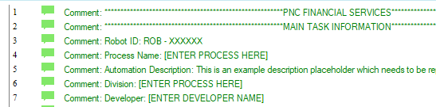
2. Development Templates
2.1 Templates Overview
Template | Description
ROB - XXXXXX | This is the overall template for the main task which contains pre-defined variables to be used within the main task as well as the subtask.
SubTaskTemplate | This task is similar to the main task template, however has some specific components for a sub-module
SubTaskErrorHandling | This is a sample error handling task with basic building blocks that should be used in every task as well as sub-task to handle errors depending on their error severity. The template has two major error severities namely critical and non-critical error, however, subsequent error severities can also be added into this task
SubTaskCleanUp.atmx | This is a clean up task used before starting automation and after completing it. It closes any open windows for applications being used within the process such as Excel, Internet Explorer etc. which might interfere with the automation.
String File | This is a basic string file that can be used to store any values that might be used within the task such as folder paths, URLs
Project Change Log | This is a template log for logging any changes occurring during the automation project such as initiation of development, environment promotion, production rollout etc.
2.2 Main Task Template
This section at the top of the code is included for inputting basic information such as the robot ID, process name, description of the process/ the automation, the division that it deals with as well as the developer involved in building the task.

Slide 4
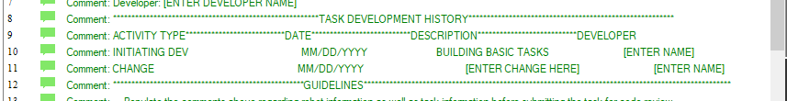
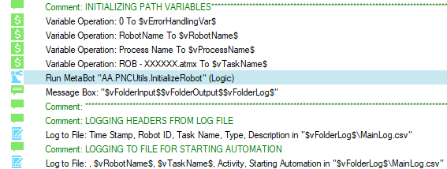
2. Development Templates
2.2 Main Task Template
This section maintains the change log on a task command level. If any changes are being made to the code, this is one place to store all of those changes. This is helpful for any developer to whom, this piece of code may be transitioned in the future
This section requires initialization for basic variables:
$vRobotName$: Enter the name of the robot here. Make sure that this name is the same as the robot folder that you create within the My Tasks folder because this is used to build the file path for the input, output, log and my tasks folder.
$vProcessArea$: This variable defines the area in which the automation lies, eg. Indirect Credit Disputes etc.
$VTaskName$: This is used for logging purposes to define the specific piece of code was executed by a bot and which task did it pertain to, thus making the log file more granular and clear.
$vFolderInput$, $vFolderOutput$, $vFolderLog$ - These variables use $AAApplictaion$ path & $vRobotName$ to build basic folder paths for input, output and the log folder. These can be used in tasks as well as sub-tasks for pointing towards folder paths.
Use the AA.PNCUtils.InitializeRobot metabot to get values of $vFolderInput$, $vFolderOutput$ & $vFolderLog$

Slide 5
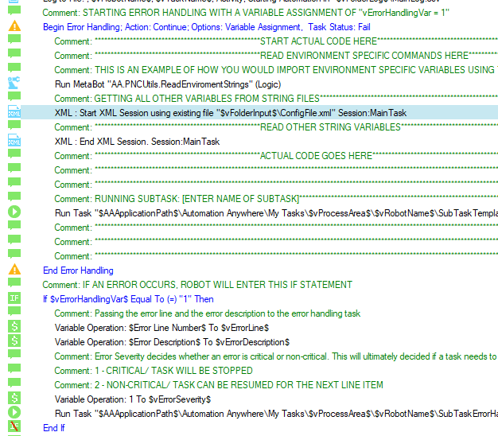
2. Development Templates
2.2 Main Task Template
This is the section where the actual code needs to be plugged in:
Reading Environment Specific Variables: This metabot logic can be used to import any environment specific variables defined within the string file corresponding to the active environment in which the bot lies.
Reading from XML File: All strings pertaining to the code should be read on the top of the code and stored into variables prefixed with “sf_x” where “x” would be the variable type such as “v” for value variable, etc.
Inner Error Handling: This error handling is to capture any error that happens within the piece of code. The only trigger in this error handling would be to initialize value of $vErrorHandlingVar$ as 1 with task action as “Continue” so that it skips to line number 57 in this case and continues from there on. Line 57 is followed by an if statement which checks if the $vErrorHandlingVar$ is equal to 1 or not. If it is equal to 1, that implies that there is an error that occurred within that task and thus, a few variable would be initialized:
$vErrorLine$ - This will be equal to system variable $ErrorLine$ and would be passed on to the error handling task
$vErrorDescription$ - This will be equal to the system variable $ErrorDescription$ and would be passed on to the error handling task
$vErrorSeverity$ - This is a pivot variable for deciding how an error needs to be handled. As of now, in the template, two major severity levels have been defined namely 1 for critical errors which stop the automation, log to a file and send an email; and 2 for non-critical errors where error line, description is logged to file and the remaining piece of code can be plugged in to roll back to any points in the systems, that the bot is interacting with, in order to continue with the next steps in the process and not necessarily stop the task. This would be specific to the process and the systems.
Running Error Handling Task – This is where the post error commands are initiated (explained in section 1.3)

Slide 6
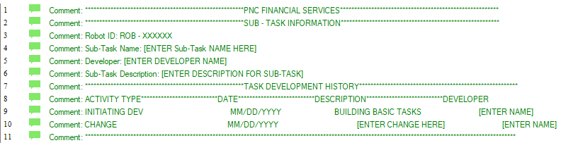
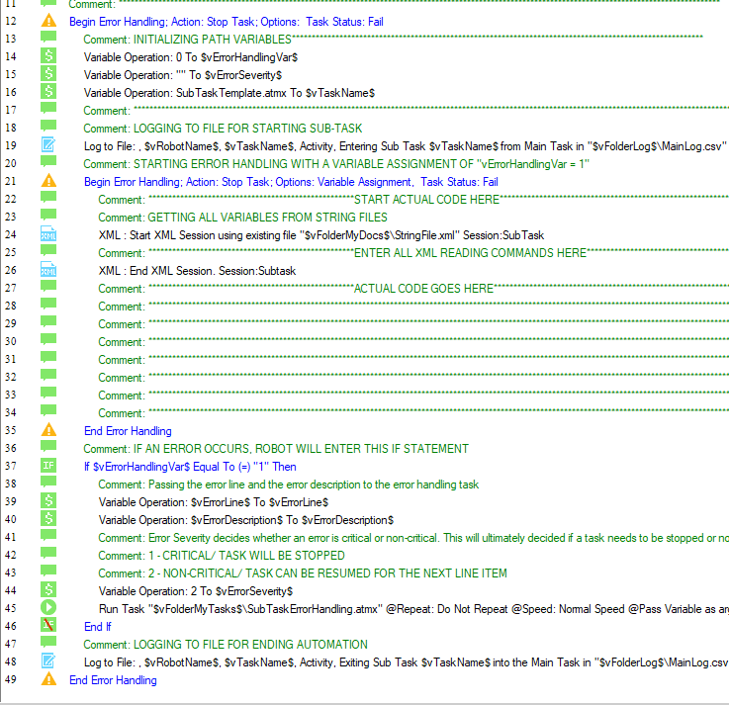
2. Development Templates
2.3 Sub-Task Template
This is similar to the main task template. The only difference here is that the developer needs to mention the function of the specific sub-task against the field, “Sub-Task-Description” and log changes corresponding to that sub-task.
This section is the same as the one mentioned in the main task – however, the only difference here is that the $vFolderPath$ variables have not been initialized since they have already been initialized in the main task and thus will be mapped to the sub-task and used within this task. Severity of subtasks is usually set to 2, since most sub-task failures may be non-critical errors which can be rolled back to the main task to resume and process the next case in the automation.
Please ensure that you initialize the $vTaskName$ variable as the name of that module which is used by the Log to File command to log activities corresponding to that specific sub-task

Slide 7
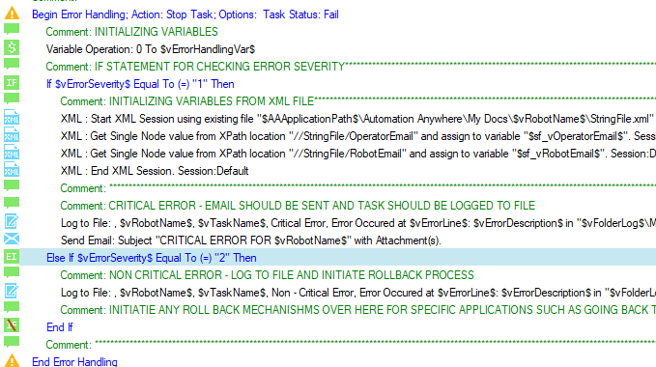
2. Development Templates
2.4 Error Handling Sub-task Template
Error handling task is used to handle errors and initiate rollback mechanisms based on the severity of the error. In this template, error severities have been divided into two portions:
Critical Error: This may be an error that occurred during logging into an application or performing an action within a main task. This error should be logged to file and an email should be sent to the robot operator stating that the robot has stopped functioning
Non-Critical Error: This is an error which should not stop the functioning of the robot. However this type of error should be logged to file and any rollback mechanism for a specific application should be initiated in this part of the code.
Any extra error severities can be added which can mark specific error instances for errors occurring within the code. This can be done by adding extra ‘Else If’ statements below the ones already mentioned.

Slide 8
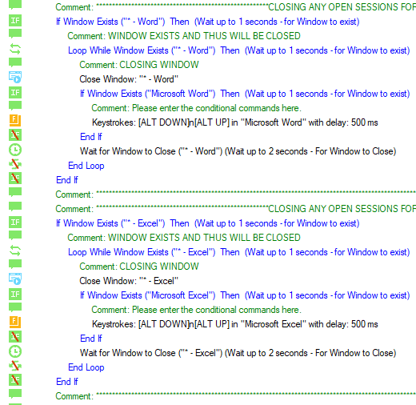
2. Development Templates
2.5 Clean-up Task Template
The cleanup tasks checks if there’s an open session for any window and loops while all the active windows for that application, regardless of the title, have been closed properly. If any of the windows has the “Do Not Save” sign, it exits out of those windows as well by choosing the “Do Not Save Changes” option. In this template, the code has been built for common applications like Word, Excel, Internet Explorer. However, the same can be built for any other application which is being used within the task.

Slide 9

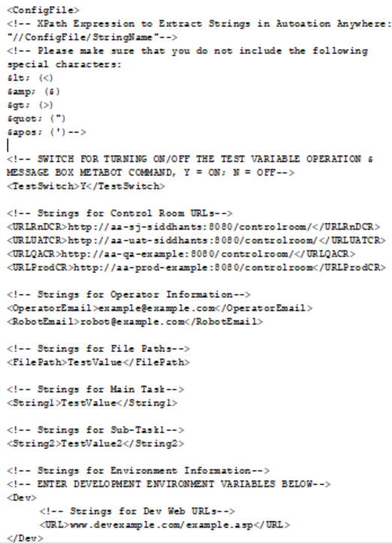
2. Development Templates
2.6 String File Template
The string file acts as a configuration file for storing variable values which are being used within the task:
Any variable value should be stored in the following format: <Identifier>Enter Variable Here</Identifier>.
The variable value can be called within a task using an Xpath expression which looks like: //StringFile/Identifier
The variable values should be read using the XML commands at the top of the code.
Any value being read from a string file should be stored in a variable which should be named as $sf_xVariable$ where ‘x’ is the type of variable such as ‘v’ for value, ‘arr’ for array etc. (Refer to variable naming convention section)
Maintain strings in separate sections of the code such as the ones enlisted in the image where every sub-task has its own section for strings. This maintains some level of organization in the string file.
Populate the ‘OperatorEmail’ and the ‘RobotEmail’ for the sake of the Send Email command in the Error Handling Task. These emails can be same if the robot does not have its own email ID.
The string file also has a set of characters that you cannot use directly within the file since they tend to corrupt the file. There are alternate characters that you can use instead of these, the key of which is given at the top of the file.
String File has environment specific sub-directories with the name of ‘Dev’, ‘QA’, ‘UAT’ and ‘Prod’ where one can store environment specific variables, which in turn can be used via the ‘ReadEnvironmentStrings’ metabot which simulates the Xpath: ‘//ConfigFile/[Environment]/[StringIdentifier]’ based on the connected control room.(Refer to Metabot Library Section)
Switch for Turning On/Off the Test Message Box and Variable Operations can either take a value of ‘Y’ to activate or ‘N’ to disable the testing metabot commands. There are separate switches for variable operations and message boxes
This ensures that if the variable value changes in the future, the identifiers will remain the same and thus the updated values would be copied to the code without changing the code itself.

Slide 10
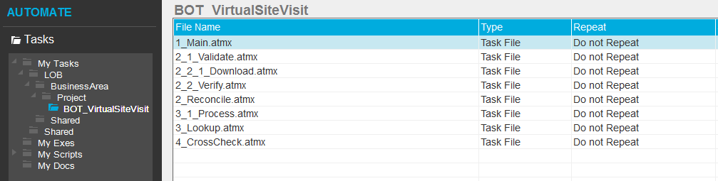
2. Development Templates
2.7 Folder Structure & File Naming Convention
Folder Naming Convention for My Tasks and My Docs Folder:
Shared → Shared bots across LOBs
LOB → Line of business
Shared → Shared bots within a LOB & BusinessArea
BusinessArea → Primary Business Area
Project Acronym → Project Short Name/Acronym
BOT_BotName → Descriptive Short Name for Bot
Caps the first letter of each word [Ex. BOT_VirtualSiteVisit]
File Naming Convention:
Name: Caps the first letter of each word ex. 2_DownloadLoanApps
1_Main → Main bot which orchestrates the calls
2_xxx → 2_xxx is being called from 1_main
2_1_xxx → 2_1_xxx is being called from 2_xxx
2_2_xxx → 2_2_xxx is being called from 2_xxx
2_2_1_xxx → 2_2_1_xxx is being called from 2_2_xxx
3_xxx → 3_xxx is being called from 1_main
4_xxx → 4_xxx is being called from 1_main

Slide 11
2. Development Guidelines
2.8 Basic Guidelines
Have meaningful names for tasks and modularize them based on their functionality
Identify redundant logic to organize into loops and/or sub-task
Each task should not exceed 500 lines of code, excluding comments.
Delete all the temp data immediately once processed
If message boxes are being used for the debug mode, make sure that they have timeouts.
Have metabots for common modules like below:
Application login and navigation
Custom functions such as String, Date, etc., [Refer to the DateTime metabot]
Custom API
2.9 Control Room Best Practices
Credential Vault Naming Convention
Follow a standard naming convention for naming variables within the credentials vault: “LOB_BusinessArea_Project Code_BotName_Vault. Ex. RET_KYC_VSV_VirtualSiteVisit_Vault”
Task Schedule Naming Convention
Follow a standard naming convention for schedules within the ‘Task Schedules’ tab: “LOB_BusinessArea_Project Code_BotName_ScheduleName. Ex. RET_KYC_VSV_VirtualSiteVisit_Schedule”
Using Credentials Vault for Config Variables
Variables such as URL for websites, File Paths for shared drives should be stored in the Credentials Vault and not in the config file. This ensures that any sudden changes in the URLs/ file paths do not lead to an emergency code promotions.
In order to import these values from the credentials vault to commands where credential variables cannot be imported, use the ‘GetCredentialVartoLocalVar’ metabot logic. (See metabots library section for details on usage).
All other values apart from these two mentioned values can be stored in the configuration file.

Slide 12
2. Development Guidelines
2.10 Variable & Task Naming Convention
Variables should be named using the following convention:
Prefix variables with ‘v’ for value variables.
Prefix variables with ‘arr’ for array variables.
Prefix variables with ‘lst’ for list variables.
Prefix variables with ‘rnd’ for random variables.
Prefix variables with ‘is’ for Boolean variables, example ‘isFound’.
Prefix variables with ‘cf_x’ for variables read from a string file where ‘x’ is the type of variable as mentioned in the 4 points above.
Variables should be named in Camel Caps. For e.g. $vFolderInput$
Variables should be as descriptive as possible for the ease of understanding the code.
Use common intuitive names such as start all folder path variables with $vFolder…$ and all URL variables with $vURL…$ since this would stack up all those variables in an alphabetical order which makes it easier to call them within tasks
Enable analytics for the variables that business wants to track
All tasks and sub-tasks should be named using the following convention mentioned in section 2.7:
Maximum Depth Level for tasks: 3 Sub-Tasks: Do not go beyond 3 levels deep when it comes to calling subtasks.
2.11 Project Change Log
The project change log should be populated frequently to reflect any updates in the bot, such as initiation of development, debugging, environment promotions, UAT Testing and production rollout.

Slide 13
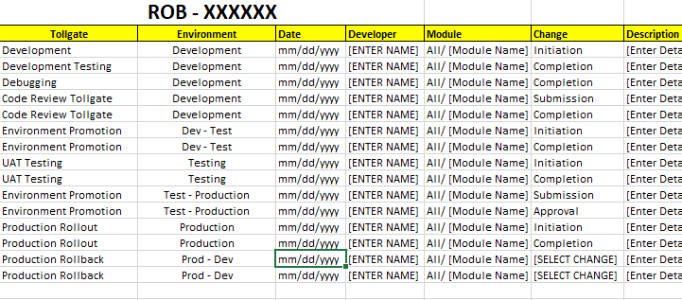
2. Development Templates
2.12 Project Change Log
This change log keeps a track of the overall progress of the project and includes granular level information corresponding to:
Initiation of Development, Testing, production rollout, rollback, debugging
Tollgate information such as submission/ approval of code review or UAT testing
It also mentions the modules which were affected by this change and the description of that change.
Items such as Tollgate, Environment and Change have their own respective dropdown values to choose from.

Slide 14
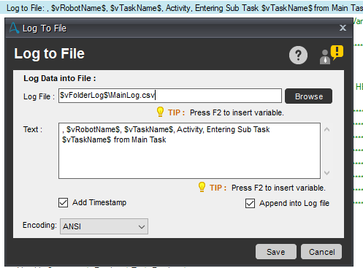
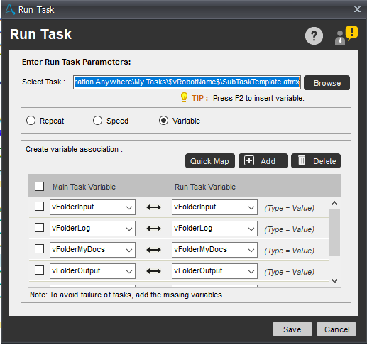
2. Development Guidelines
2.13 Log to File
The “Log to File” command should be used frequently in the code to log either an Activity or an Error (in the error handling task). This serves two purposes:
It enables you to look at the log and debug the code based on bot activity and nature of error
It helps create a comprehensive audit trail of all the granular level activities that the bot is performing.
Mention the $vFolderLog$ folder for pointing towards the exact folder path for log.
2.11 Run Task
Use the ‘Quick Map’ feature to map the variables form the main task to the sub-task. In order to quick map the variables, the task needs to be browsed and path values need to be hard-coded.
Once quick mapping has been done, use $AAApplicationPath$ to replace the component of the path: “C:\Users\[Username]\Documents\Automation Anywhere Files”. Your path should look something like this:
[$AAApplicationPath$\Automation Anywhere\My Tasks\[Rest Of Folder Path]\Bot file.atmx]
Do not use any other variables in the path than $AAApplicationPath$

Slide 15
2. Development Guidelines
2.12 Recording Commands, Keystrokes
Prioritize Click over Left Click. If Click does not work, resort to left clicks.
Use DOMX, if it does not have any hardcoded properties such as ‘tr[1]td[2]…’. These properties tend to change from environment to environment.
If the DOMX Path encapsulates the HTML ID and HTML Tag in a manner similar to \a[@id=“PushButton”] where “a” is the HTML Tag and “PushButton” is the HTML ID, either check just the DOMX Path, or check both HTML ID and HTML Tag.
For Web Pages, priority order for commands is:
1st - Web Recorder
2nd – Object Cloning
3rd – Manage Windows Controls
4th – Keystrokes
5th – Mouse Clicks/ Mouse Moves
There might be cases where keystrokes may be stronger and faster than an object cloning (if it is unstable). It really depends on the websites. But keystrokes do act as good alternatives to recording
Delay for Object Cloning versus delay for keystrokes: While setting text using an Object Cloning command, the delay simulates a stipulated millisecond delay between two characters or the string being types. However, in case of a Keystrokes command, the delay mentioned is the overall delay used for typing the string.
Avoid using the “Path” property within object cloning, unless there isn’t any other alternative property such as an “HTML ID”/ “HTML Tag” which can be used to detect an object.
For Web Applications, HTML ID, HTML Tag are pretty robust properties to select objects on the screen.
2.13 Recommended Delays
It is recommended to add delays between any “Files/Folder” commands that deal with copying a file from one location to the other and moving it. This is because copying and deleting is dependent on system latencies which can vary based on deployment infrastructure such as deploying on VMs versus deploying on actual machines.
Delay values should be stored in string file and called within the task using an XML command, in order to store them in variables. This allows easy tweaking of delay values throughout the code
Using Dynamic delays such as “Wait for Window to Open/Close”, “Wait Till File Exists for x seconds” is a much better approach than hardcoding delays within the code.

Slide 16
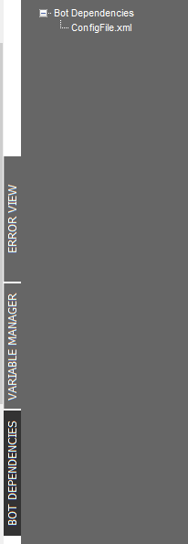
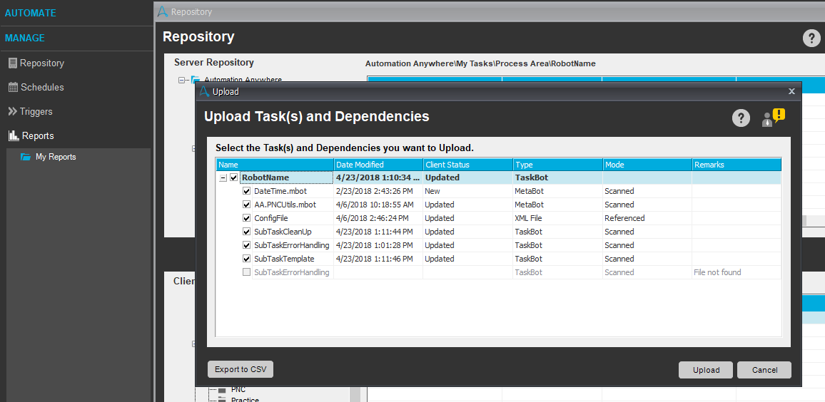
2. Development Guidelines
2.14 Dependency Manager
All files which act as a dependency for the bot should be added as a dependency within that specific task. In this case, the configuration file is being used as a dependency within the maintask. This ensures that the Config file is also uploaded on the repository along with the task files, when uploaded using the Manage-> Repository function within the client.
The image below represents the window that appears while uploading the task on the server using the function within the client which scans the sub-tasks called within the main task and marks them as dependencies automatically.
For the dependencies added within the dependency manager, they would be referenced as dependencies .

Slide 17
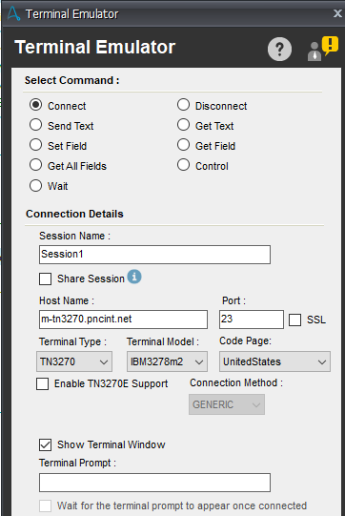
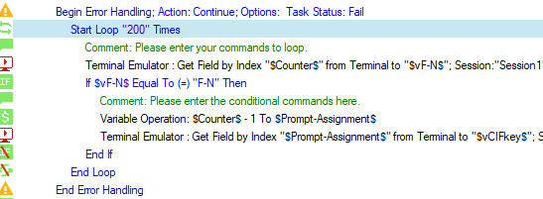
2. Development Guidelines
2.15 Terminal Emulator
Typical settings for simulating the mainframe system, simulated by Bluezone in the as is process are displayed in the image on the left.
Every field/text element on a mainframe has a corresponding index value which is numeric or a field value which looks something like “R7C6” for example. While working with mainframe screens, it is recommended to build a small login to scrape through the screen and get all the fields using the “Get All Fields” commands, store the text and the corresponding Field Name/ Field Index in a text/ XML file and then work out of that to get specific fields or enter text in specific fields.
It is recommended to add delays between two terminal emulator commands which involve getting text froma screen, entering text, navigating to another page, clearing text etc. This is done because terminal emulator functions really fast and thus, it may tend to skip some commands due to the inherent delay in the mainframe. Thus, adding delays.
If a mainframe has multiple fields, the fields along with their corresponding field indices and values can be stored in an XML file using a schema and imported within the code using an
If a particular mainframe screen has a dynamic index (i.e. dynamic because there might be more or less data on the screen due to conditional fields, thus changing the index numbers), in order to scrape through the screen, a logic like the one on the right can be used.
In this logic, 200 is a big number which is beyond the maximum number of index numbers that any mainframe screen can have. This number can change from screen to screen and thus, 200 is more of an upper limit.
$Counter$ variable helps us loop through each field and gets the value corresponding to that number. If that field contains the identifier that one is looking for, the code within the if statement will be executed.
Any index beyond the last valid index will throw an error which would be captured by the Error handling Command.

Slide 18
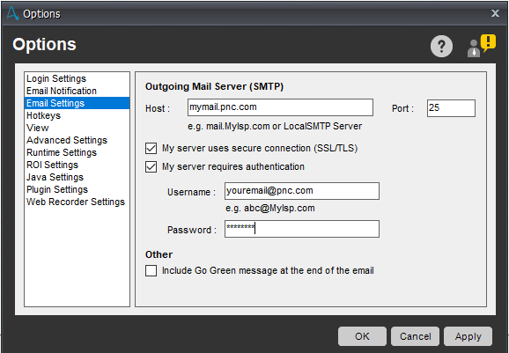
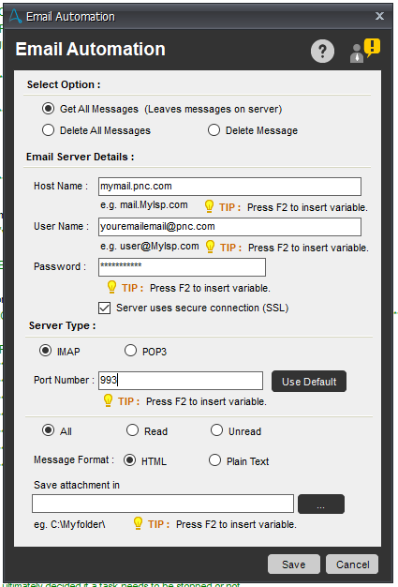
2. Development Guidelines
2.16 Outgoing Email Settings
2.16 Incoming Email Settings
Incoming Email server settings are used for monitoring an email inbox based using the Email Automation Command. The settings for the same have been displayed in the image.
Outgoing email settings are configured by navigating to Tools -> Options within the main Enterprise Client Screen. Toggle to Email Settings, and enter values as shown in the image above.

Slide 19
3. Metabot Library
3.1 AA.PNCUtils
AA.PNCUtils metabot is a cumulation of multiple utilities available, that can be used within the task frequently. Currently the AA.PNCUtils metabot has the following logics with the following functions:
Logic | Input | Output
InitializeRobot | Process area – The process area folder within My Tasks Robot Name – Name of the robot folder | Input Folder – Mapped to $vFolderInput$ Output Folder – Mapped to $vFolderOutput$ Log Folder – Mapped to $vFolderLog$
ReadEnvironmentStrings | Config File Location – Enter file path here Connected Control Room – Use $AAControlRoomVariable$ | Value – Value corresponding to that identifier, based on the environment to which the variable is connected to.
ReadFromStringFile | File Path – Place where string file is stored (Should be made dynamic in the code) String Identifier: Adding this identifier simulates the Xpath Function //ConfigFile/[StringIdentifer], thus returning the value against the the string, stored in the output variable | Output String – This is the value corresponding to that key executed via the mentioned Xpath function.
TestMessageBox | Config File Path – File Path for Configuration File Test Switch - The metabot reads whether the value corresponding to the “TestMessageSwitch” node in the config file is “Y” (for turning on testing mode) or “N” (for turning off) | Nil
TestHardCodeVariableOperation | Config File Path – File Path for Configuration File Test Switch - The metabot reads whether the value corresponding to the “TestVariableSwitch” node in the config file is “Y” (for turning on testing mode) or “N” (for turning off) Test Value – This is the testing value which needs to be initialized to the variable. Variable To Be Tested – The variable for which the test value needs to be initialized | Variable To Be Tested – The variable for which the test value needs to be initialized. This value will be initialized to the Test Value Mentioned only if the test switch is set to “Y” in the configuration file.

Slide 20
3. Metabot Library
3.1 AA.PNCUtils
AA.PNCUtils metabot is a cumulation of multiple utilities available, that can be used within the task frequently. Currently the AA.PNCUtils metabot has the following logics with the following functions:
Logic | Input | Output
TestConfigVariableOperation | Config File Path – File Path for Configuration File Test Switch - The metabot reads whether the value corresponding to the “TestVariableSwitch” node in the config file is “Y” (for turning on testing mode) or “N” (for turning off) Test Key – This is the Key for the value stored in the configuration file against it, specifically in the TestValues directory. Variable To Be Tested – The variable for which the test value needs to be initialized | Variable To Be Tested – The variable for which the test value needs to be initialized. This value will be initialized to the Test Value Mentioned only if the test switch is set to “Y” in the configuration file.
GetCredentialVartoLocalVar | CredentialVar: This will take any credential variable from the vault. When you hit F2, you can pass in credential variables to the metabot | CredentialVar: This returns back the credential variables which can be stored in a local variable.

